Slide 1
Managing Devices
Identify the Types of Linux Devices
Configure Devices
Monitor Devices
Troubleshoot Hardware Issues

Slide 2
The Importance of Device Drivers
Drivers are an interface between OS and device.
Crucial for devices to function in Linux.
Great strides have been made to write Linux-compatible drivers.
May still be compatibility issues in certain cases.
No matter the device, make sure:
Device drivers are available.
Your system has those drivers.
Without drivers, the device may function poorly or not at all.

Slide 3
Thin Clients (Slide 1 of 2)
Lightweight computing devices that connect to more powerful servers for doing work.
Server does heavy lifting (processing, storage, etc.).
Thin client is little more than a user interface.
This architecture centralizes and streamlines operations.
Linux has robust remote connection support.
Thin client can have I/O devices connected.
Thin client can run a lightweight distro with restrictions.
Server can create virtual environment for client to work in.
Both client and server may be Linux, or only one, or neither.

Slide 4
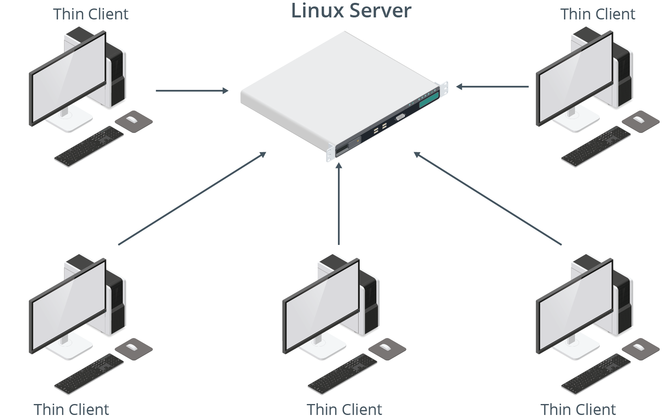
Thin Clients (Slide 2 of 2)

Slide 5
USB Devices
The de facto standard interface technology used to connect peripheral devices to computers.
Also incorporates plug-and-play features.
Some supported types:
Thumb drives
External HDDs/SSDs
Digital cameras
Smartphones/tablets
Printers/scanners
Keyboards/mice
Microphones/webcams
Game controllers

Slide 6
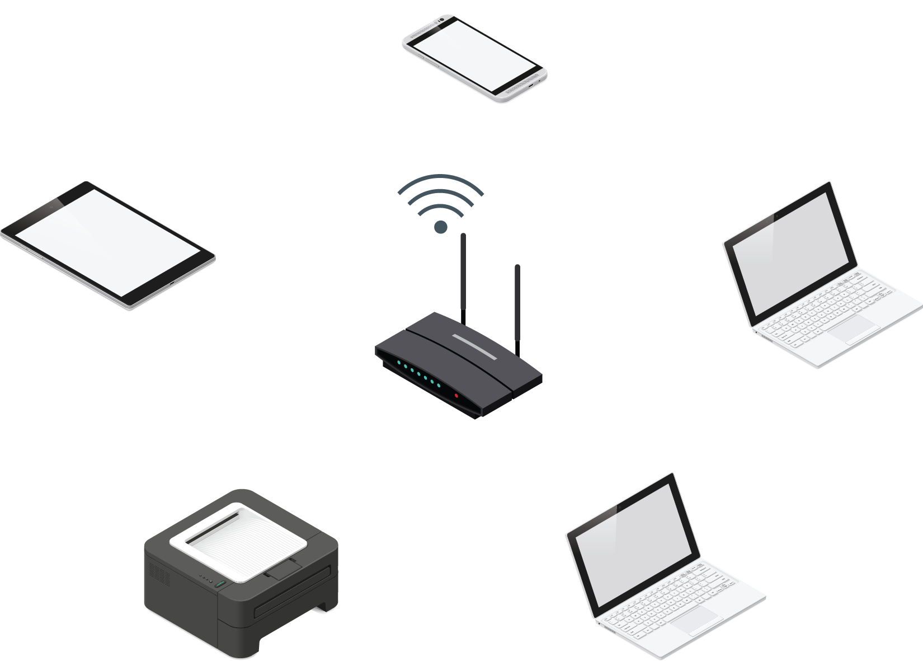
Wireless Devices
Transmit/receive signals over the air.
Common protocols:
Wi-Fi
Bluetooth
NFC

Slide 7
Video and Audio Devices
I/O peripherals usually attached to client systems.
Video input: webcams, surveillance cameras, digital cameras.
Video output: monitors, televisions, projectors.
Audio input: microphones, some video input devices.
Audio output: speakers, headphones, some video output devices.
Connection types are important.
Microphones/webcams use USB.
USB not reliable for streaming audio/video output.
Monitors use HDMI/DisplayPort to carry both video and audio.
Older monitors use DVI/VGA to carry video only.

Slide 8
Printers
Linux supports printers and printing software.
Support is dependent on available drivers and quality of drivers.
Has improved over the years.
Use multiple connection methods.
USB for physical connection.
Wi-Fi and/or Ethernet adapter for network connection.
Popular in offices; multiple clients connect to same printer.
Linux computers can act as print management servers.

Slide 9
Network Adapters
A device that provides an interface with which hosts exchange data over a network.
Required for a computer to access any network.
Often built into motherboard.
Some can be added to expansion buses.
Some can be connected externally through USB.
System can have more than one.
Common on servers and security systems.
Each connection protocol requires its own adapter.

Slide 10
GPIO (Slide 1 of 2)
Pins on a circuit board that have no designated purpose, but are controllable at runtime.
Pins send and receive digital signals.
Examples:
Output pin can turn LED light on/off.
Input pin can be turned on/off by external light switch.
Controlled programmatically through software.
Developer can design app to interact with outside world.
Found on single-board microcontrollers (Arduino, Raspberry Pi).
Can be used in IoT space.
Raspbian and other distros can control GPIO through programming libraries.

Slide 11
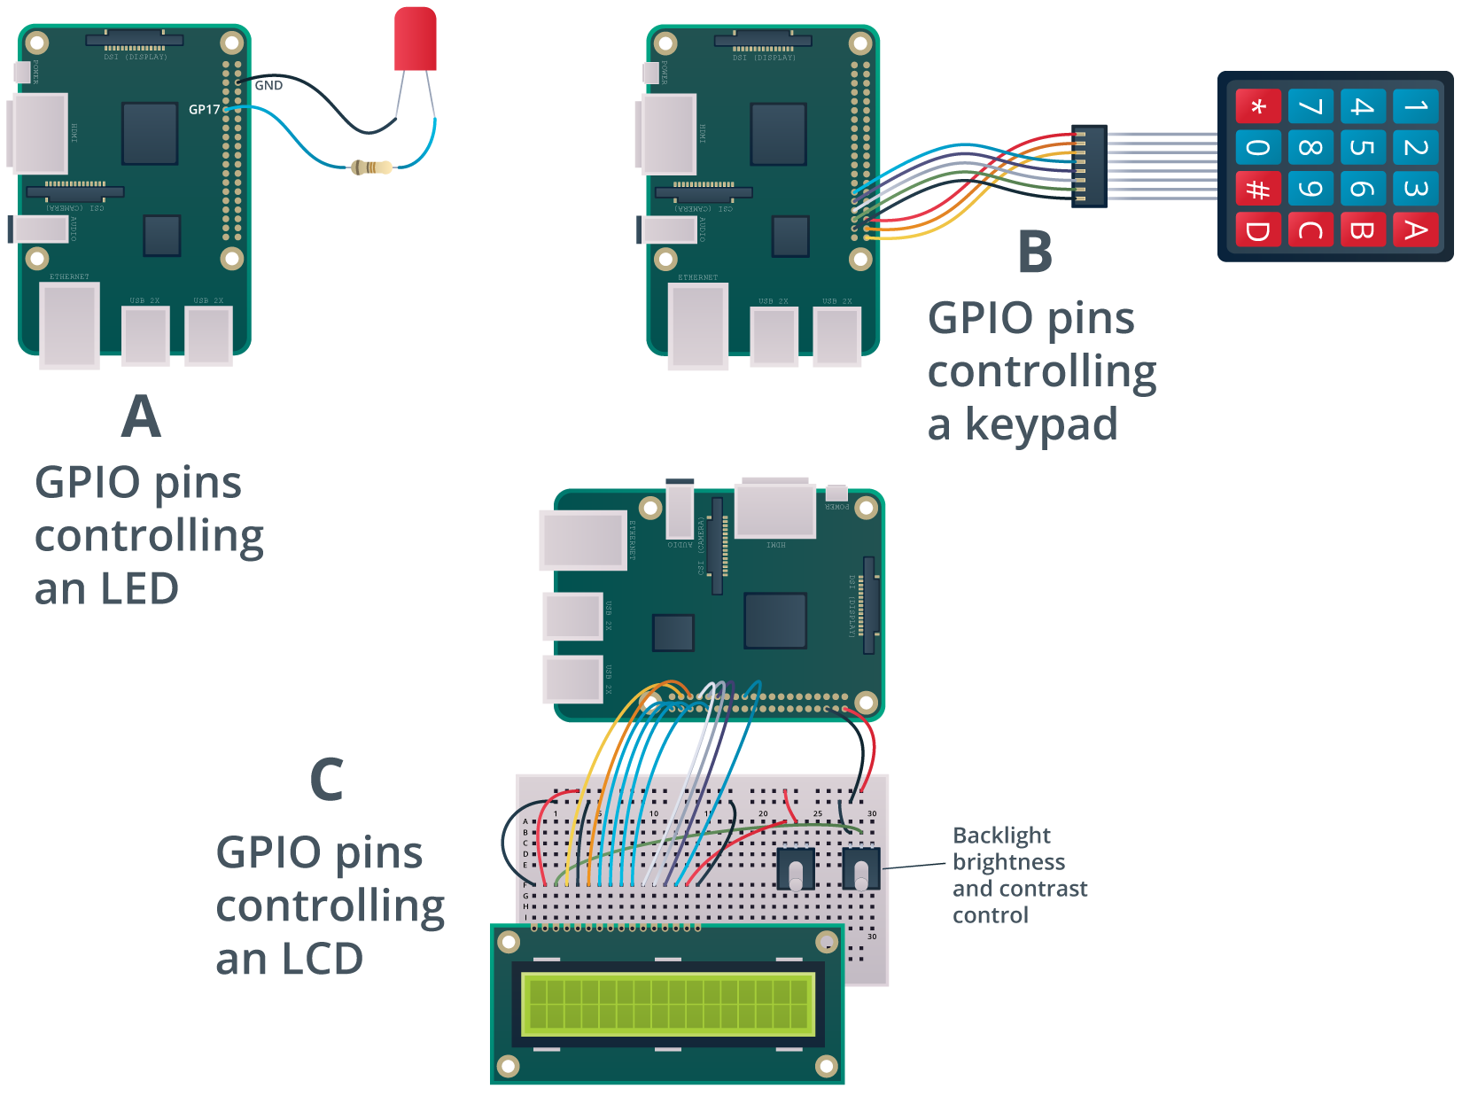
GPIO (Slide 2 of 2)

Slide 12
SATA
A computer bus interface standard for attaching storage devices to traditional computers.
Largely replace PATA/IDE in PCs.
Offers high capacity and low cost.
Older versions have lower transfer rates.
Less suitable for enterprise storage.
Used for backups and consumer storage.
Current revision (3.2) is up to 16 Gb/s.
Combines SATA with PCIe.
Standard SATA (3.1) is up to 6 Gb/s.

Slide 13
SCSI
A computer bus interface for connecting peripheral devices to traditional computers.
SATA used for storage; SCSI used for storage and peripheral devices.
Use in storage is more common.
Traditional SCSI uses a parallel interface.
More costly than serial.
Provided high transfer rates in the past.
Was popular for enterprise storage.
SAS applies serial technology to SCSI.
Much faster (up to 24 Gb/s in SAS-4).
Supports higher capacities.
More reliable.
Now the go-to for enterprise storage.

Slide 14
HBA
A hardware component that connects a host system to a storage device in order to facilitate the input and output of data.
Is to storage devices what NICs are to networks.
Used with interfaces like SATA, SCSI, etc.
Built into motherboard or as a separate expansion card.
You connect storage device to HBA.
Enables system to work with device.

Slide 15
PCI
A connection interface standard that is primarily used as an expansion bus for attaching peripheral devices.
Superseded by PCIe.
Greater transfer speeds.
More reliable error detection.
Smaller size.
Dominant expansion bus technology.
PCIe used for video cards, expansion cards, etc.
PCIe also used for connecting NVMe SSDs.
Even faster than SSDs in SATA/SAS.
Will become more prominent in enterprise storage.

Slide 16
Activity: Identifying the Types of Linux Devices
You need to configure/maintain devices for clients/servers.
You need to apply this to Linux environments.
First, ensure you know the common devices and how they connect.

Slide 17
Device File Locations
Location | Description
/proc/ | Files representing info reported by kernel. /proc/devices lists all character/block devices.
/sys/ | Creates hierarchical view of device info. /sys/devices/ includes files that expose device details.
/dev/ | Device driver files. Example: Mount block device through /dev/sda1 /dev/mapper includes LVs, encrypted devices, etc.
/etc/ | Config files for many components. /etc/X11/ has files for configuring I/O devices impacting X.Org Server.

Slide 18
Hotpluggable Devices
Devices that can be physically added or removed from the system without requiring a reboot.
Detected by system when plugged in.
Coldpluggable devices are not; require a complete reboot.
RAM, CPUs, internal storage, etc.
Some coldpluggable devices require system to be powered off.
Modern distros support hotplugging for many bus types.
USB, FireWire, PCIe, etc.

Slide 19
udev
A device manager that automatically detects and configures hardware devices.
A function of systemd.
Initialized during boot.
Handles configuration for both hotpluggable/coldpluggable devices.
Loads coldpluggable modules when system is booted.
Loads hotpluggable modules dynamically during runtime.

Slide 20
udev Rules
Add rules files in /etc/udev/rules.d/
Rules tell udev to configure device/run command when plugged in.
Example: Create symbolic link on device plugin.
You always can refer to device in the same way.
Don't have to rely on /dev/sda1, /dev/sdb2, etc.
Refer to device by unique attributes (e.g., vendor/product ID).
Example rule:
KERNEL=="sd*", ATTRS{idVendor}=="334455", ATTRS{idProduct}=="667788", SYMLINK+="myusb"
Name file in format ##-name.rules

Slide 21
The udevadm Command (Slide 1 of 2)
Manages udev to modify runtime behavior.
Subcommand | Used To
info | Retrieve device info/attributes stored in udev database or /sys/
control | Modify running state of udev.
trigger | Execute rules that apply to plugged-in devices.
monitor | Watch for events sent by kernel or udev rule.
test | Simulate udev event running for a device.

Slide 22
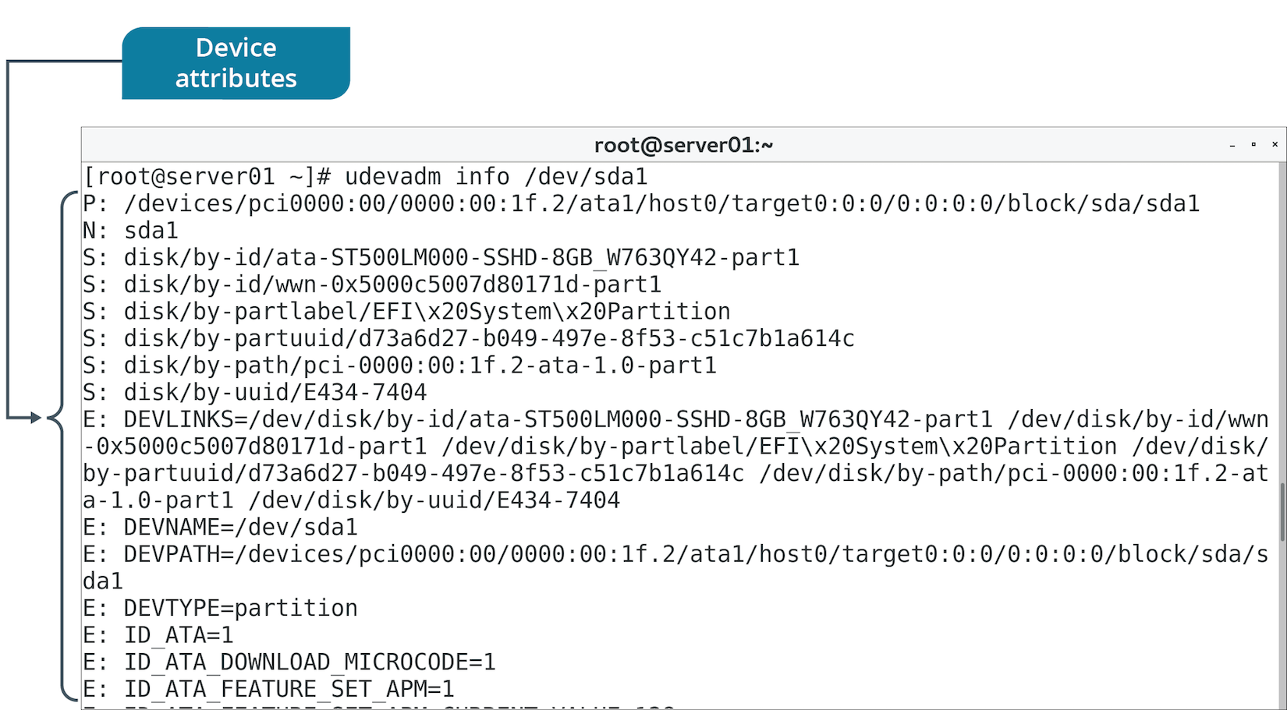
The udevadm Command (Slide 2 of 2)

Slide 23
Printing Software
Printers are usually bundled with software utilities.
Enable you to configure printer settings.
May only run on specific OSs.
You can still use Linux utilities.
Vendors usually provide drivers for download on their websites.

Slide 24
CUPS (Slide 1 of 2)
A print management system for Linux that enables a computer to function as a print server.
System running CUPS can initiate print jobs from clients.
Jobs are processed and sent to appropriate printer.
Can process different data formats on same print server.
Designed for:
Scheduling jobs.
Processing admin commands.
Providing printer status.
Has web-based interface for configuration.
Modifies /etc/cups/cupsd.conf and /etc/cups/cups-files.conf

Slide 25
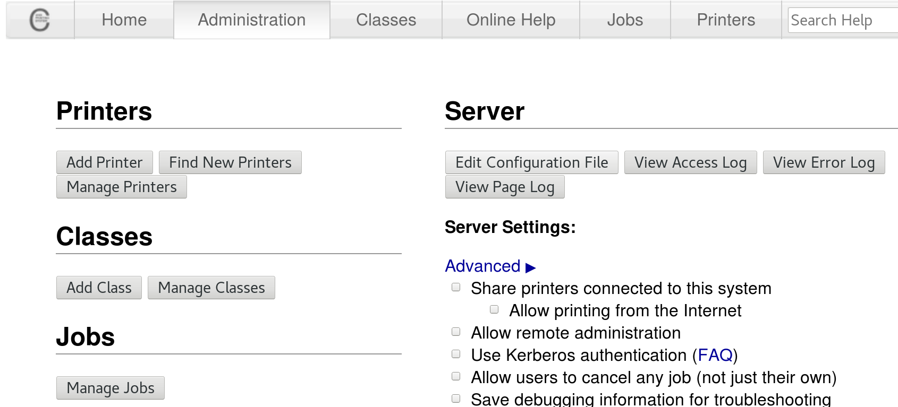
CUPS (Slide 2 of 2)

Slide 26
The lpr Command
Submits files for printing.
Files are sent to specified printer or job queue.
If no printer is specified, default printer is used.
Configurable through CUPS.
Reads print file from stdin if no files are supplied.

Slide 27
Discussing Configuring Devices

Slide 28
Activity: (Optional) Using udev to Manage a Hotpluggable Device
A colleague preps installation media on a USB drive.
System assigns non-descriptive name to drive.
She wants to reference the drive using a more helpful name.
You'll use udev to create a symbolic link to the drive.
Will activate every time the drive is plugged in.
Will be based on device's unique attributes.

Slide 29
Activity: Configuring a Virtual (PDF) Printer
HR wants to distribute AUP to employees.
Will use both hardcopy and electronic.
Right now, you don't have a real printer set up.
You can still print to a PDF for electronic distribution.
You'll need to set up a virtual printer first.

Slide 30
The lsdev Command
Displays info about system hardware.
Compiles info from:
/proc/interrupts
/proc/ioports
/proc/dma

Slide 31
The lsusb Command (Slide 1 of 2)
Displays info about devices connected to USB.
Scans /dev/bus/usb/ directory.
Prints number of bus/device, device ID, and vendor/product.
Use -v flag to see more detail about each device.
Filter results by bus (-s) and vendor/product (-d).

Slide 32
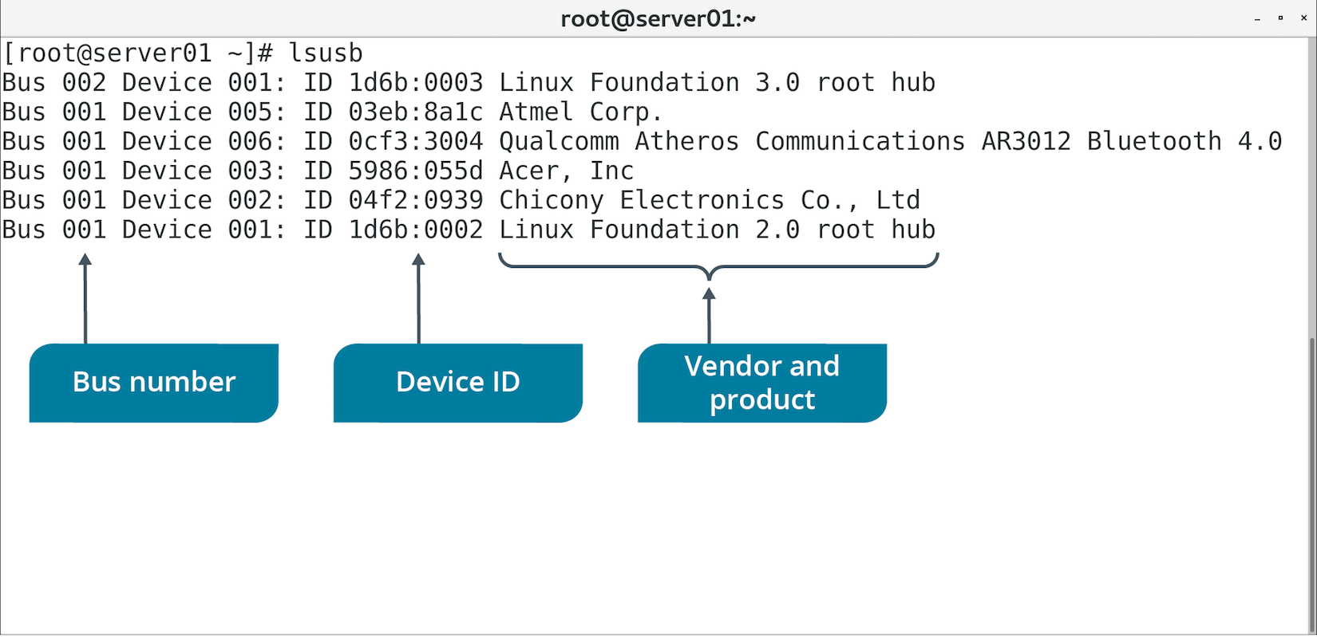
The lsusb Command (Slide 2 of 2)

Slide 33
The lspci Command (Slide 1 of 2)
Displays info about devices connected to PCI bus.
Lists logical slot address, device class, and vendor/product.
Includes verbose option for more details about devices.

Slide 34
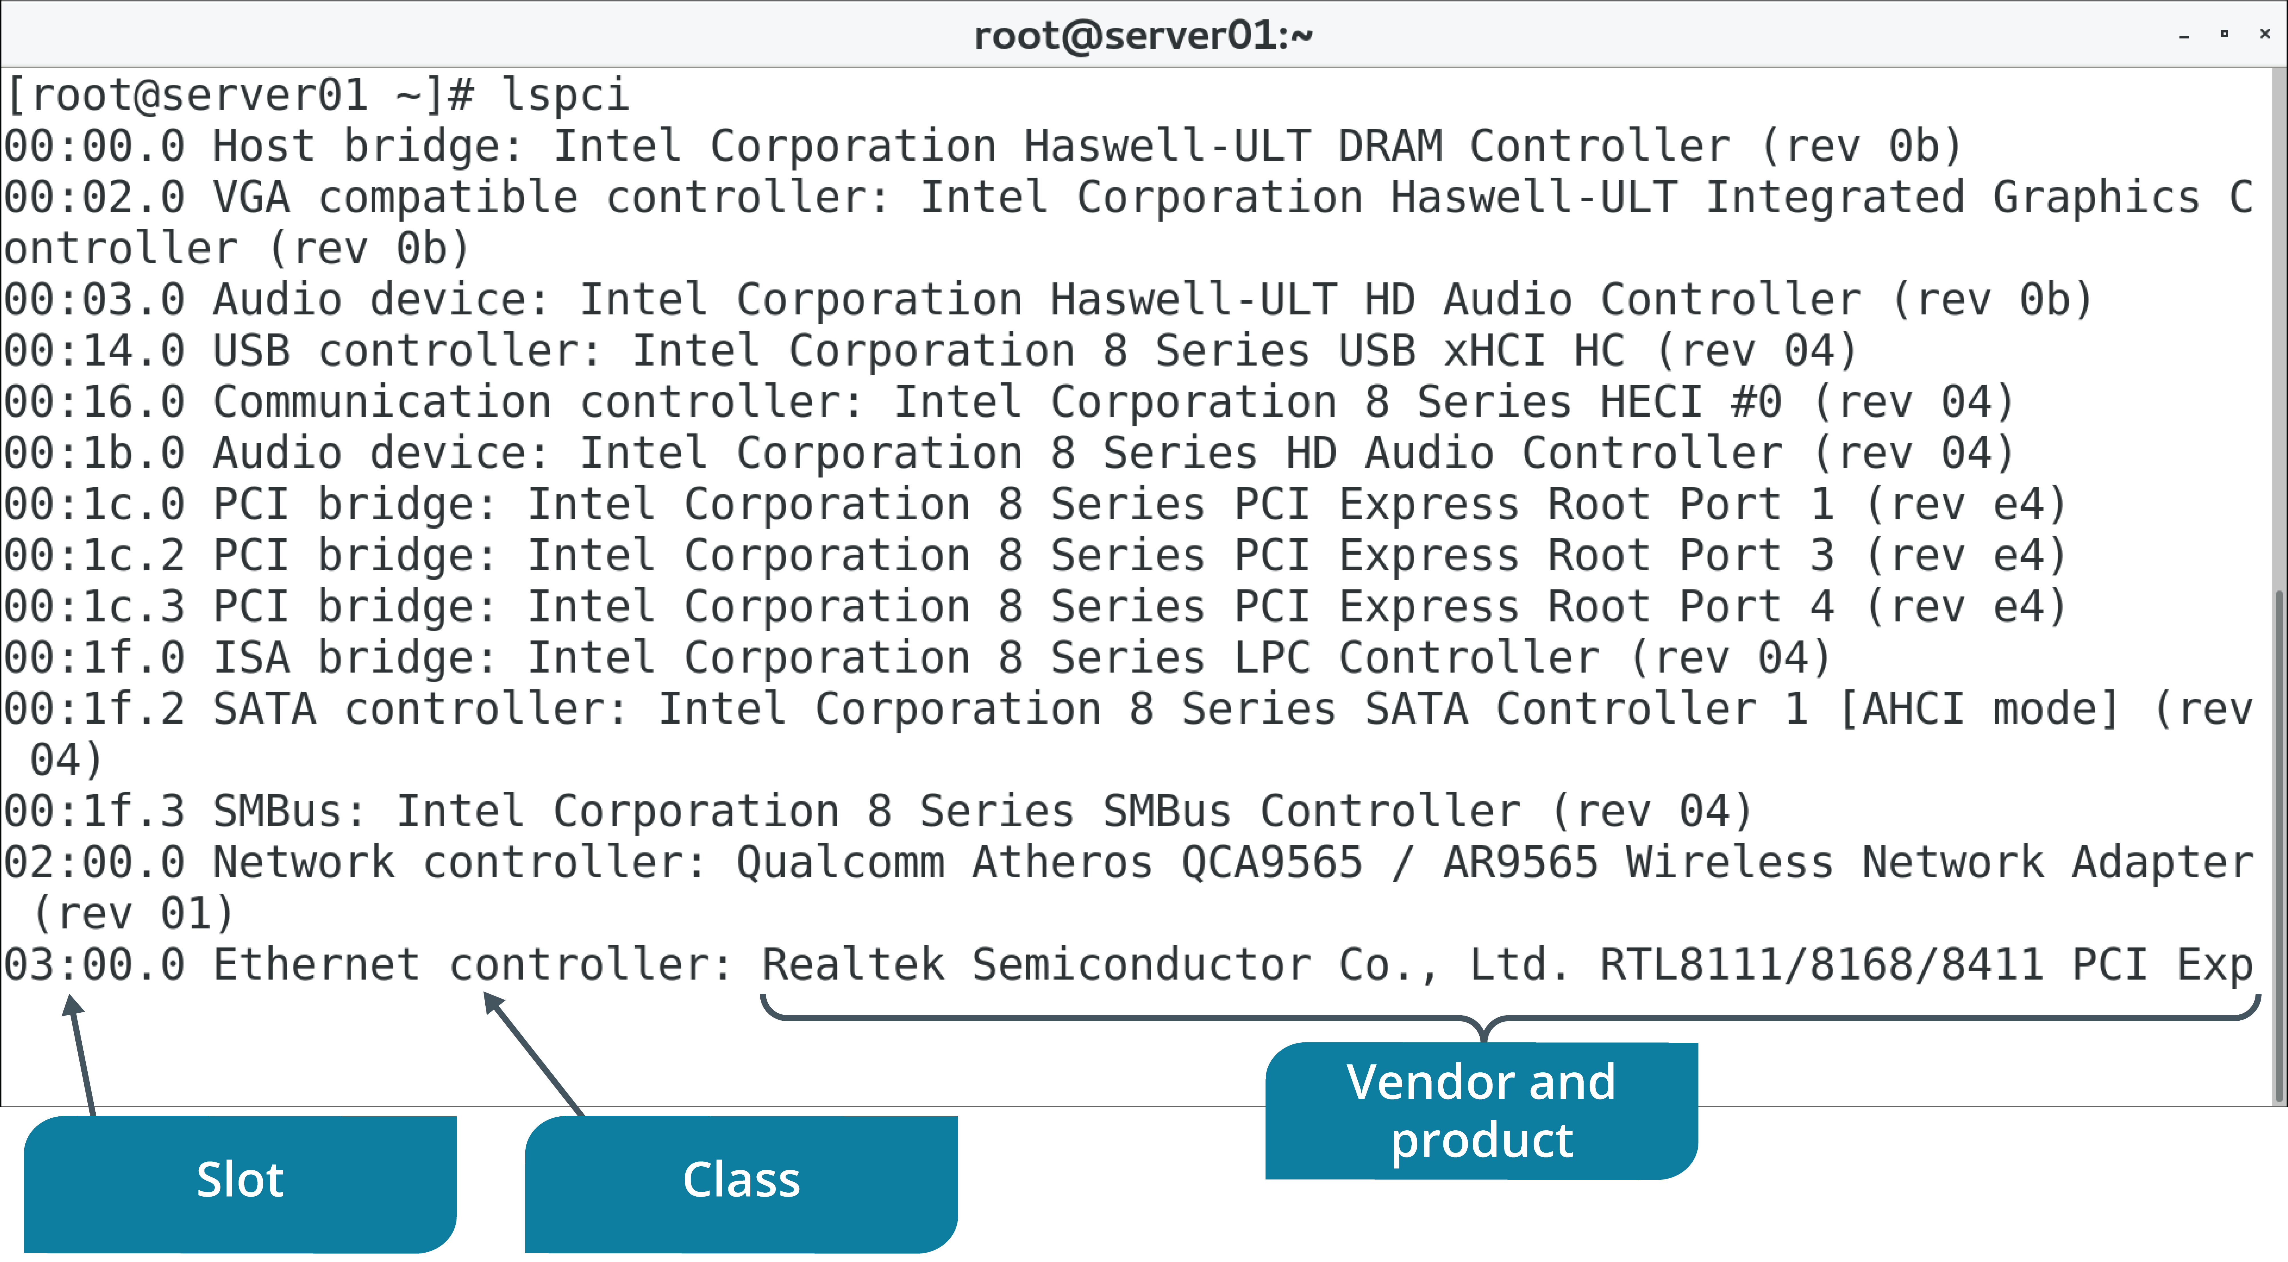
The lspci Command (Slide 2 of 2)

Slide 35
The lpq Command (Slide 1 of 2)
Shows status of printer queue.
Reports for each job:
The job's rank.
Who owns the job.
The name of the files in the job.
The size of the job.
Use +interval to update report every specified number of seconds.
Will use default printer if none specified.

Slide 36
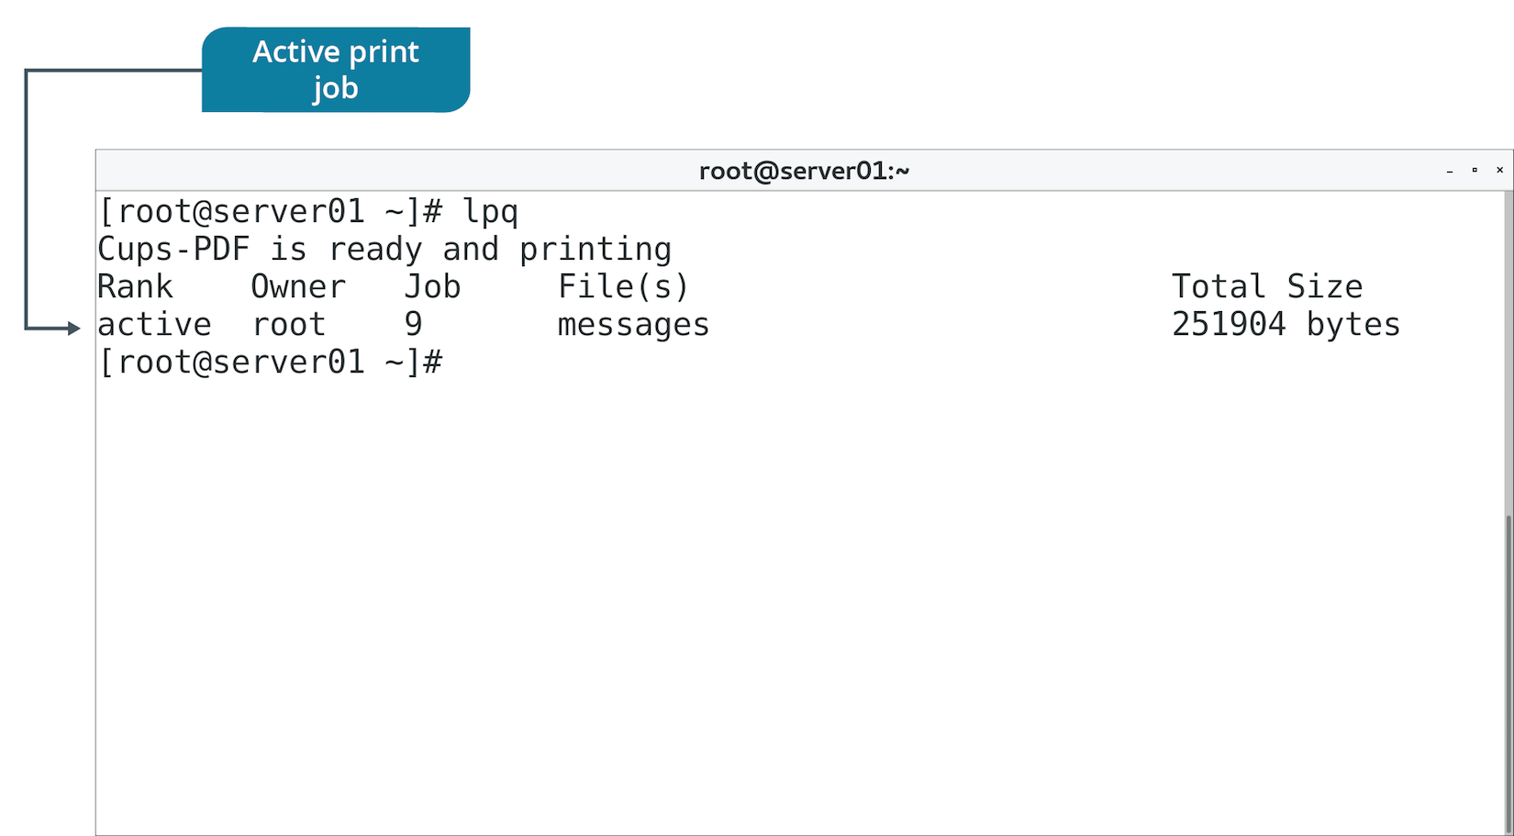
The lpq Command (Slide 2 of 2)

Slide 37
Additional Device Monitoring Tools
Some tools you've used before can also be useful in monitoring devices.
Example: lsblk
Identify block storage devices.
Ensure devices are recognized.
Ensure devices are correctly partitioned/mounted.
Example: dmesg
Show device driver messages sent to kernel.
Can include errors in operation or module loading failures.
Monitor for issues related to drivers or underlying hardware.

Slide 38
Discussing Monitoring Devices

Slide 39
Activity: Monitoring Devices
You need to track devices used on all computers in network.
You need to maintain a list of hardware resources in use.

Slide 40
Common Hardware Issues
Common sources of problems:
Missing or poorly configured drivers.
Incompatible user space software.
There are many other potential sources.
And many other potential solutions.
Issue categories:
Keyboard mapping
Communications port
Printer
Memory
Video
Storage adapter

Slide 41
Keyboard Mapping Issues
Certain keys may produce unexpected results when pressed.
Common symptom of keyboard mapping issues.
Wrong keyboard layout/language may be configured.
Start by identifying the layout of the actual keyboard.
Layouts differ based on overall design and language/region.
Use localectl status to see what layout is configured.
If it's wrong, find the correct one, then set it.
May need to adjust system language as well.

Slide 42
Communications Port Issues
Ports may fail to recognize attached devices.
Connection may be unreliable.
Ensure:
Device is slotted into port.
Cables are undamaged/not loose.
HBA is powered.
Device supports correct bus version.
Also install/load necessary drivers.
Certain serial devices will request a console interface to Linux.
Usually assigns /dev/ttyS#
Ensure device is configured to access these consoles.
Only root can access them by default; may need to change permissions.

Slide 43
Printer Issues
A very common source of issues.
Printer itself might be at fault.
Consult the help manual/manufacturer's site.
Ensure your printer has compatible drivers and that they're loaded.
Use network diagnostic tools if you can't connect to a networked printer.
A printer with too much load might be unresponsive.
Multiple users try to print at once.
Use lpq to check job status.
Use lprm {job #} to stop large or numerous jobs.
Clearing up queue lightens the load on the printer.

Slide 44
Memory Issues
Memory can leak.
Process fails to free up memory when done with it.
Memory is exhausted.
Performance degrades.
Use memory/process monitoring tools to identify problem.
Address offending process as necessary.
Some issues are with the physical RAM.
"Machine Check Exception" errors during operation.
mcelog retrieves error messages.
ECC errors indicate RAM failure.
Use memory testing tools to stress test RAM.

Slide 45
Video Issues
Common issues:
Blank screens
Wrong colors
Multiple monitors not detected
Sluggish performance
Ensure display devices are connected properly and are compatible.
GPU driver support has been less robust than on Windows.
Has improved in recent times.
Make sure you have the latest drivers.
Ensures optimal video performance.
Download from vendor's website.

Slide 46
Storage Adapter Issues
Symptoms:
Poor data transfer speeds.
Reduced capacity.
Read/write errors or complete failures.
Devices not detected.
Ensure HBA is powered.
Ensure HBA uses appropriate interface.
Older versions may not offer expected performance.
Ensure devices are slotted and cables are connected.
Rescan a SCSI bus if new device isn't detected:
echo "- - -" > /sys/class/scsi_host/host#/scan
Can be disruptive.

Slide 47
The lshw Command (Slide 1 of 2)
Lists each detected hardware component and details.
Pulls details from multiple device file locations.
Outputs vendors, product names, specifications, and more.
Motherboard, CPU, RAM, peripherals, storage, etc.
Use to identify if device is recognized by kernel.
Use to review device's capabilities.

Slide 48
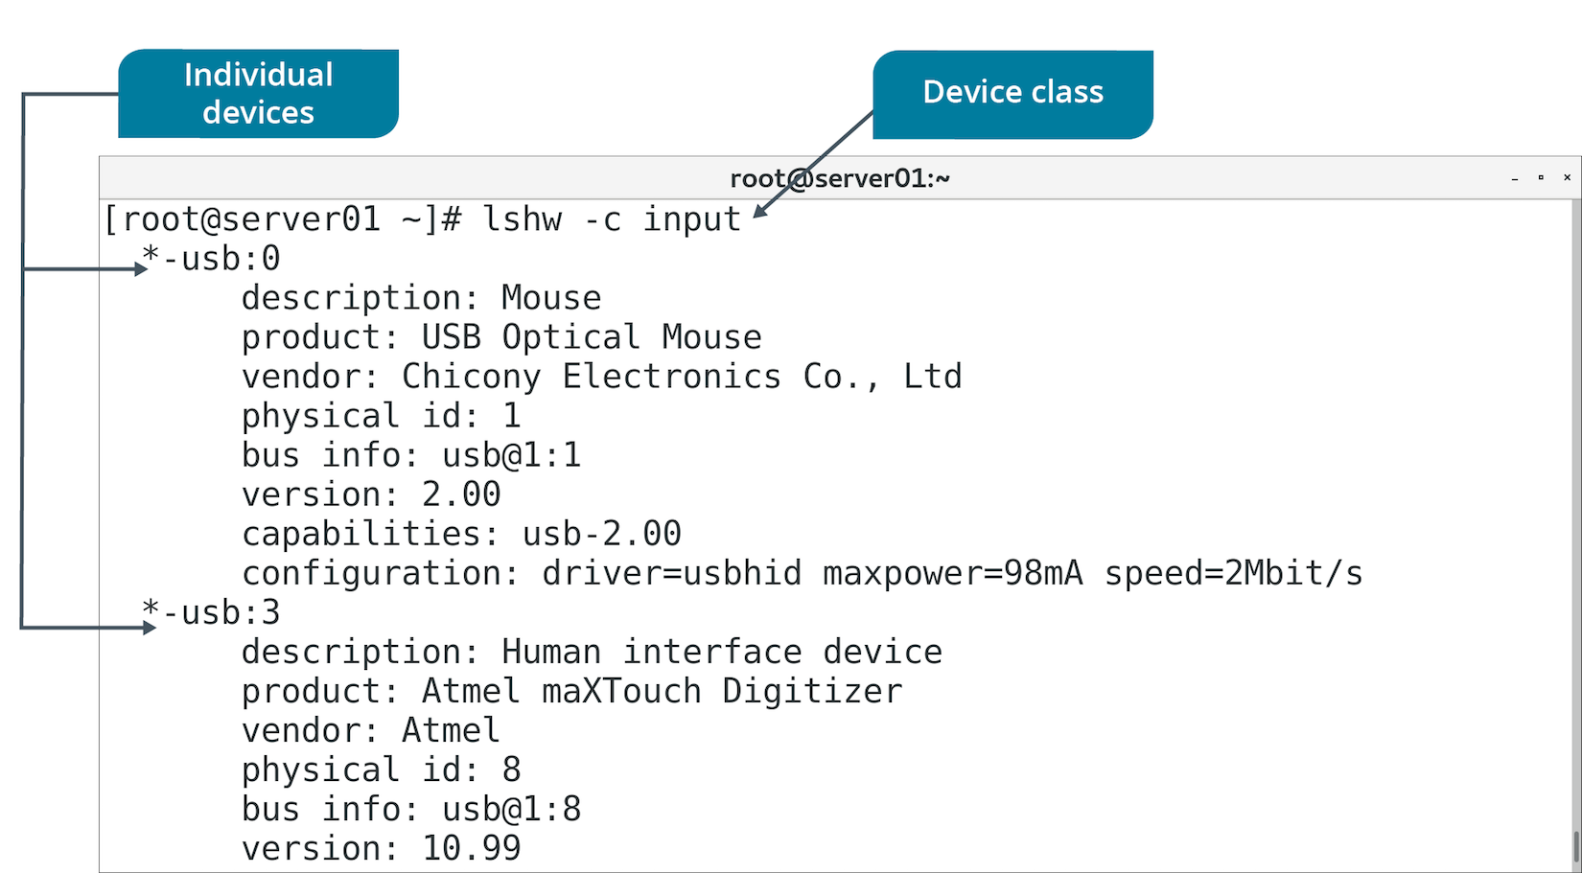
The lshw Command (Slide 2 of 2)

Slide 49
The dmidecode Command
Dumps DMI table and presents it in human-readable format.
DMI table is an industry standard for tracking hardware.
Separates hardware into types.
Verify if devices are connected and their supported features.
DMI tables are often inaccurate or incomplete.
Don't rely on them as sole source of info.

Slide 50
ABRT
A utility that analyzes and reports on problems detected during system runtime.
Primarily for Fedora- and RHEL-based distros.
Collects data like memory dumps from crashed apps.
Helps diagnose and troubleshoot problems.
Can report on hardware device problems like MCEs.
Can redirect problem data to multiple destinations.
Issue trackers, local files, remote files, etc.
Default location for problem data is /var/spool/abrt

Slide 51
Guidelines for Troubleshooting Hardware Issues
Ensure devices are supported by drivers.
Ensure drivers are installed and loaded.
Ensure hardware devices are compatible with Linux software.
Verify system has correct keyboard layout/language.
Verify that network printer is identifiable on the network.
Use lprm to stop problematic print jobs.
Check mcelog for memory errors.
Run a memory testing utility if you suspect RAM failure.
Download latest GPU drivers.
Ensure devices are properly slotted into correct buses.
Ensure cables are not loose or damaged.
Use lshw to identify hardware on the system.
Be aware dmidecode may be inaccurate.
Review crash data compiled by ABRT.

Slide 52
Activity: Troubleshooting Hardware Issues
Your systems fulfill many purposes, and interface with many kinds of hardware.
You need to troubleshoot inevitable hardware issues.

Slide 53
What type of storage and peripheral bus interface(s) do you use in your organization, or do you expect to use?
What are the most common hardware issues that you or your colleagues experience in the workplace?

